Slide 1
Predict Breast Cancer
Treatment Using
Machine Learning
Juntian Xiao, Yuhong Yuan, Luqi Xin, Qifeng He, Guangzheng Dong

Slide 2
Background AND LITERATURE REVIEW

Slide 3
Background
Prevalence of Breast Cancer
Breast cancer is the most common cancer among women in the UK.
Chemotherapy's Role and Limitations
While chemotherapy is a standard pre-surgical treatment, it is highly toxic and not universally effective.
Importance of PCR and RFS
Pathological complete response (PCR) at surgery correlates with better outcomes and longer relapse-free survival (RFS). However, only 25% of patients achieve PCR through chemotherapy.
Need for Predictive Models
Developing methods to predict PCR and RFS using pre-treatment data could enhance patient stratification and treatment effectiveness.
Notes:
Breast cancer is the most common cancer among UK women. Chemotherapy, while effective in some cases, is toxic and not universally successful. Achieving pathological complete response (PCR) at surgery improves outcomes and prolongs relapse-free survival (RFS), but only 25% of patients reach this goal. Predictive models using pre-treatment data could optimize patient stratification and improve treatment success rates

Slide 4
Literature review on existing solutions
Effective Algorithms
Support Vector Machines (SVMs) consistently outperform other ML
Artificial Neural Networks (ANNs) show strong performance on complex datasets and demonstrate potential in deep learning applications
Hybrid Models
Ensemble techniques (combining SVM and Decision Trees) enhance diagnostic accuracy and adapt to diverse healthcare environments
Challenges in Data Processing
Inconsistent feature dimensions and missing or redundant data
Unbalanced sample
Practical Applicability
Algorithms must balance performance with scalability and usability
Future Directions
Integrate multi-modal datasets for more robust predictions
Notes:
Machine learning (ML) techniques, particularly Support Vector Machines (SVMs) and Artificial Neural Networks (ANNs), are highly effective for breast cancer prediction. SVMs excel in sensitivity and specificity, while ANNs demonstrate superior performance on complex datasets. Hybrid models, such as ensembles combining SVM and Decision Trees, enhance diagnostic accuracy and adaptability.
However, there are still many challenges to overcome, especially in data processing. Breast cancer datasets often have inconsistencies, missing values, and redundancy, necessitating robust preprocessing and feature selection. These steps are critical for improving model efficiency and prediction reliability. Future research can focus on integrating multi-modal data and addressing data heterogeneity to improve scalability and applicability in diverse healthcare settings.

Slide 5
PROPOSED METHOD

Slide 6
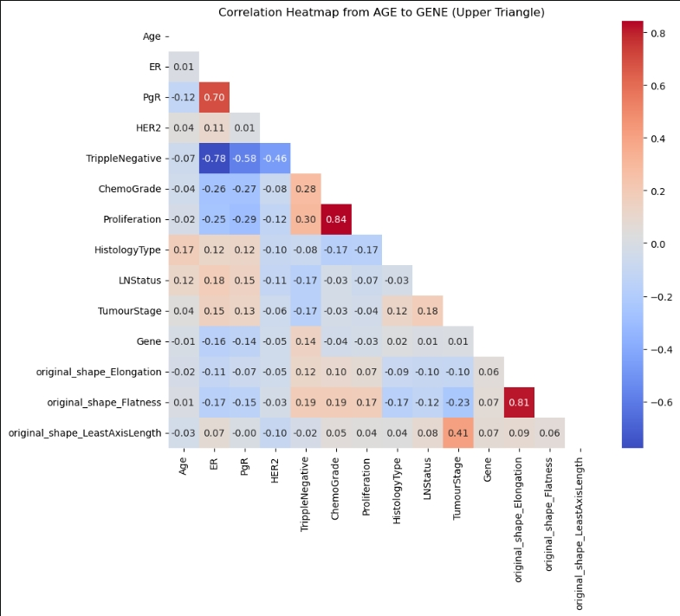
Proposed method - PCR
Data processing
Median Imputation
Continuous missing values and categorical encoding for variables like 'Gene' with substantial missing data
Normalization and Scaling
Ensure feature values are standardized, improving model performance
Principal Component Analysis (PCA)
Reduce dimensionality while preserving critical variance in the dataset
Class Imbalance Handling
SMOTENC (Synthetic Minority Over-sampling Technique for Nominal and Continuous features)
Balance the dataset, ensuring improved recall for minority classes without overfitting.
The correlations between individual data features and select efficient strategies to process your data.
Notes:
Data Preprocessing
To tackle missing values, inconsistent feature dimensions, and skewed distributions, the preprocessing stage employs median imputation to fill missing data and normalization to standardize feature scales. Additionally, Principal Component Analysis (PCA) is utilized to reduce dimensionality, preserving critical variance while minimizing data complexity.
Class Imbalance Handling
Given the imbalance in breast cancer datasets, particularly in minority classes, the method uses SMOTENC to generate synthetic samples for underrepresented categories. This balances the dataset distribution, improving the model’s ability to detect minority classes without overfitting.
And also sse Seaborn to map the thermal mapping of the data to see the correlations between individual data features and select efficient strategies to process your data.

Slide 7
Proposed method - PCR
Model Selection
Random Forest (RF)
To handle high-dimensional data and provide feature importance insights.
AdaBoost Classifier
For its adaptive enhancement capabilities, especially in imbalanced datasets.
Logistic Regression
As a baseline for comparative evaluation. The models will be optimized through hyperparameter tuning, including threshold adjustments and cross-validation, to ensure robustness.
Notes:
Model Selection
Three models are selected for evaluation: Random Forest (RF), AdaBoost Classifier, and Logistic Regression. Random Forest is chosen for its ability to handle high-dimensional data and provide feature importance insights. AdaBoost is included due to its adaptive enhancement mechanism, which effectively addresses imbalanced data. Logistic Regression serves as a baseline model for comparative analysis.

Slide 8
Proposed method - RFS
Data processing
Median Imputation
Continuous missing values and categorical encoding for variables like 'Gene' with substantial missing data
Normalization and Scaling
Ensure feature values are standardized, improving model performance
Principal Component Analysis (PCA)
Reduce dimensionality while preserving critical variance in the dataset
Class Imbalance Handling
SMOTENC (Synthetic Minority Over-sampling Technique for Nominal and Continuous features)
Balance the dataset, ensuring improved recall for minority classes without overfitting.

Slide 9
Proposed method - RFS
Model Selection
Random Forest (RF)
To handle high-dimensional data and provide feature importance insights.
AdaBoost Classifier
For its adaptive enhancement capabilities, especially in imbalanced datasets.
Logistic Regression
As a baseline for comparative evaluation. The models will be optimized through hyperparameter tuning, including threshold adjustments and cross-validation, to ensure robustness.

Slide 10
EVALUATION RESULTS

Slide 11
Evaluation results- PCR
Model | Precision (Class 0) | Recall (Class 0) | F1-Score (Class 0)
RandomForest (75estimators) | 0.87 | 0.77 | 0.82
AdaBoost (170 estimators) | 0.92 | 0.74 | 0.82
LogisticRegression (C=1.2) | 0.89 | 0.76 | 0.82
 | Precision (Class 1) | Recall (Class 1) | F1-Score (Class 1)
RandomForest | 0.42 | 0.59 | 0.49
AdaBoost | 0.45 | 0.76 | 0.57
LogisticRegression | 0.42 | 0.65 | 0.51
 | Accuracy | Balanced Accuracy | ROC-AUC
RandomForest | 0.73 | 0.6812 | 0.6812
AdaBoost | 0.7468 | 0.7533 | 0.7533
LogisticRegression | 0.7342 | 0.7026 | 0.7026
Evaluate models
Balanced accuracy
Precision
Recall
F1-score
ROC-AUC
Ensure reliability across both balanced and imbalanced scenarios
Notes:
Best Model: AdaBoost demonstrates the best overall performance, particularly excelling in handling the minority class (Class 1) and achieving the highest balanced accuracy and ROC-AUC.
Other Models: While Random Forest is robust in majority class recall, it lags in minority class identification. Logistic Regression provides a competitive baseline but falls behind AdaBoost in key metrics

Slide 12
Evaluation results- RFS
Model | Precision (Class 0) | Recall (Class 0) | F1-Score (Class 0)
RandomForest (75estimators) | 0.87 | 0.77 | 0.82
AdaBoost (170 estimators) | 0.92 | 0.74 | 0.82
LogisticRegression (C=1.2) | 0.89 | 0.76 | 0.82
 | Precision (Class 1) | Recall (Class 1) | F1-Score (Class 1)
RandomForest | 0.42 | 0.59 | 0.49
AdaBoost | 0.45 | 0.76 | 0.57
LogisticRegression | 0.42 | 0.65 | 0.51
 | Accuracy | Balanced Accuracy | ROC-AUC
RandomForest | 0.73 | 0.6812 | 0.6812
AdaBoost | 0.7468 | 0.7533 | 0.7533
LogisticRegression | 0.7342 | 0.7026 | 0.7026
Evaluate models
Balanced accuracy
Precision
Recall
F1-score
ROC-AUC
Ensure reliability across both balanced and imbalanced scenarios
Notes:
Best Model: AdaBoost demonstrates the best overall performance, particularly excelling in handling the minority class (Class 1) and achieving the highest balanced accuracy and ROC-AUC.
Other Models: While Random Forest is robust in majority class recall, it lags in minority class identification. Logistic Regression provides a competitive baseline but falls behind AdaBoost in key metrics

Slide 13
CONCLUSION

Slide 14
Conclusion

Slide 15

Thank you
Notes:
At the University of Nottingham, we're not just a place of learning, we're a powerhouse of change.
We are built on the ethos that education can unlock potential and transform lives – driving our commitment to delivering excellence in teaching, learning and student experience.
From Nobel prize winners to entrepreneurs, engineers and artists, we have long been home to those with the vision and ambition to do things differently.
We deliver world-leading research that brings real-world change - transforming lives and societies, and shaping our future.
We encourage and support all our students to be courageous and curious. Learning today so that they can change the world tomorrow.
With more University of Nottingham graduates entering highly skilled employment than any other UK university, it’s no wonder we’re one of the UK’s top universities targeted by leading employers. (HESA Graduate Outcomes, classification of full-time, UK graduates entering work in the UK from 2018/19 to 21/22, published 2024)

